Slide 1
Amazon Sales Data Analysis
Mohini Eknath Surve

Slide 2
Introduction:
This project aims to analyze Amazon sales data using Power BI, Python, and SQL. The objective is to gain insights into sales trends, customer preferences, and business performance by processing, visualizing, and analyzing large datasets.
SQL is used for data storage, cleaning, and querying.
Python is utilized for data preprocessing, advanced analytics, and automation.
Power BI is employed for interactive data visualization and reporting.

Slide 3
Project Goals:
Understand sales trends – Analyze revenue, best-selling products, and seasonal patterns.
Customer behavior analysis – Identify top customers, buying patterns, and feedback.
Inventory management – Track stock levels and predict demand.
Profitability insights – Evaluate product profitability and return rates.

Slide 4
Column Name | Data Type
invoice_id | INT (Primary Key)
Branch | VARCHAR(50)
City | VARCHAR(50)
Category | NVARCHAR(50)
Unit_Price | FLOAT
Quantity | INT
Date | DATE
Time | TIME
Payment_Method | VARCHAR(50)
Rating | FLOAT
Profit_Margin | FLOAT

Slide 5
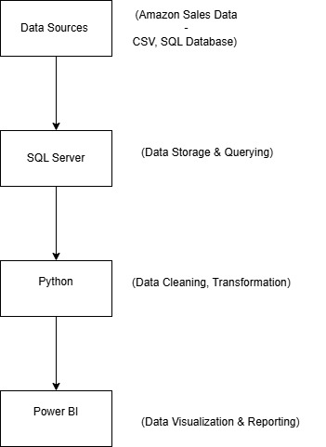
Architecture diagram

Slide 6
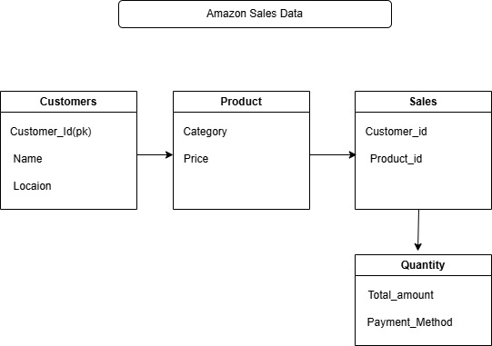
Erd diagram

Slide 7
Power BI Dashboard
Sales trend over time
Top products/categories
Region-wise performance
Profit & revenue metrics

Slide 8
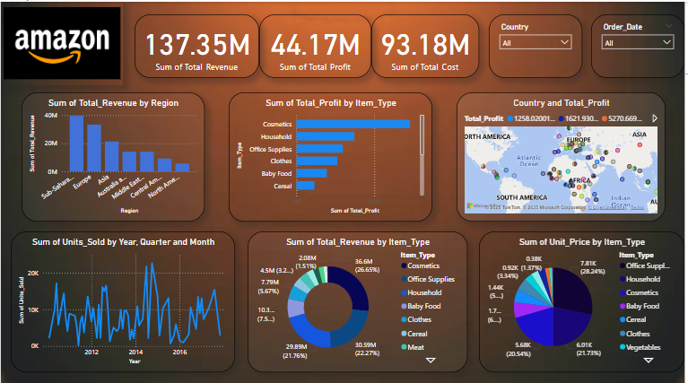

Slide 9
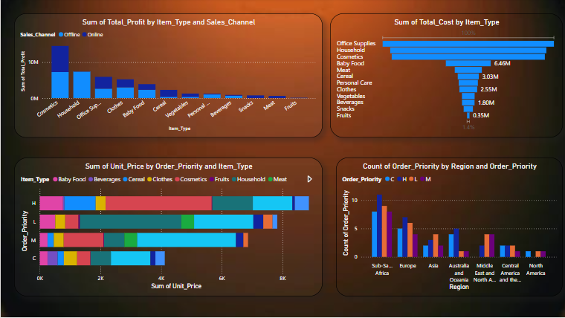

Slide 10
Future Scope
Sales Forecasting
Predict future sales using historical data to support business planning.
Customer Segmentation
Group customers based on buying patterns for targeted marketing.
Real-Time Dashboard Integration
Connect Power BI to real-time sales data for up-to-date decision-making.
Automated Reporting
Set up scheduled reports in Power BI to reduce manual work.

Slide 11
THANK YOU!.....

